Slide 1
MSSQL
Triggers –Tetikleyiciler
Transactions – İşlemler

Slide 2
TETİKLEYİCİLER
Bir tablo üzerinde INSERT, UPDATE, veya DELETE işlemleri üzerinde gerçekleştirilen saklı yordamlar.

Slide 3
TETİKLEYİCİLER
DDL (Data Definition language) Triggers
  (CREATE, ALTER, DROP)
DML (Data Manipulation Language) Triggers
  After Trigger (using FOR/AFTER CLAUSE)
  Instead of Trigger (using INSTEAD OF CLAUSE)
CLR (Common Language Runtime) Triggers
  C# …
LOGON Triggers

Slide 4
Tetikleyiciler- Başlangıç
İlk satır CREATE TRIGGER içermeli
Tetikleyiciler view, geçici tablo veya sistem tablosunda oluşturulamaz.
Tetikleyiciler view veya geçici tabloları hedefleyebilir.

Slide 5
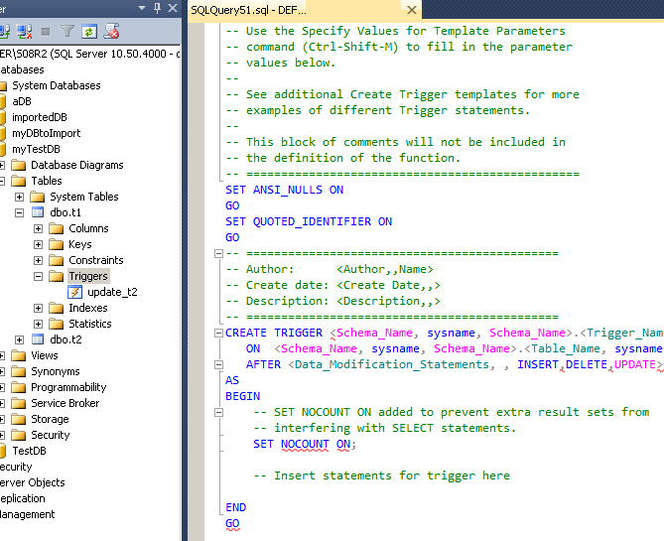

Slide 6
CREATE TRIGGER trigger_name
ON {table|view}
[WITH ENCRYPTION|EXECUTE AS]
{FOR|AFTER|INSTEAD OF} {[CREATE|ALTER|DROP|INSERT|UPDATE|DELETE ]}
[NOT FOR REPLICATION]
AS
sql_statement [1...n ]

Slide 7
LAB-örnek
triggerorn klasörü
  DB_tables
    SQL query1
    SQL query2
  trig
    SQL query3
    SQL query3_1
    SQL query3_2
    SQL query4
    SQL query4_1

Slide 8
I have two tables, ShoppingList and ShoppingListFood.
ShoppingListFood is linked to ShoppingList via a foreign key on ShopListID.
I wish to update the LastModifiedDate column in the ShoppingList table whenever there is any update / insert done at the ShoppingListFood table.
Is it possible??

Slide 9
CREATE TRIGGER trg_UpdateShoppingListFood ON dbo.ShoppingListFood
AFTER INSERT, UPDATE AS UPDATE dbo.ShoppingList SET LastModifiedDate = GETDATE() WHERE ShopListID IN (SELECT DISTINCT ShopListID FROM Inserted)

Slide 10
AFTER INSERT
shopList
  SQLQuery1-7

Slide 11
NELER YANLIŞ GİDEBLİR?
Eğer çok fazla kullanılırsa performans sıkıntılarına yol açabilir. (bloklama/kilitleme)
Doğru yazılmadıysa veri kaybına yol açabilir.

Slide 12
Transactions
ACID
Atomicity: ensures that all operations within the work unit are completed successfully; otherwise, the transaction is aborted at the point of failure, and previous operations are rolled back to their former state.
Consistency: ensures that the database properly changes states upon a successfully committed transaction.
Isolation: enables transactions to operate independently of and transparent to each other.
Durability: ensures that the result or effect of a committed transaction persists in case of a system failure.

Slide 13
Transaction Control Commands
COMMIT: to save the changes.
  COMMIT;
ROLLBACK: to rollback the changes.
  ROLLBACK;
  ROLLBACK TO SAVEPOINT_NAME;
SAVEPOINT: creates points within groups of transactions in which to ROLLBACK
  SAVEPOINT SAVEPOINT_NAME;
  RELEASE SAVEPOINT SAVEPOINT_NAME;
SET TRANSACTION: Places a name on a transaction.
  SET TRANSACTION [READ WRITE | READ ONLY ];

Slide 14
TRANSACTION ÖRNEK
transactOrn
  SQLQuery1-4
  SQLQuery4_1

